Slide 2
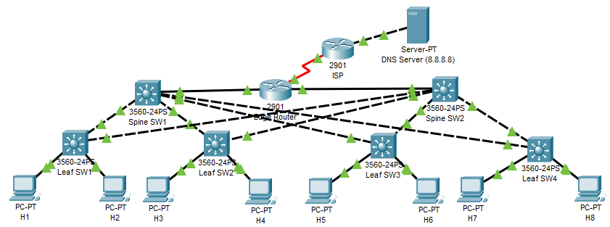
H1 ARP Leaf Sw1
H1 ping H2 from different network

Slide 3
Leaf Sw1 ARP H1
H1 ping H2 from different network

Slide 4
H1 ICMP Leaf Sw1
H1 ping H2 from different network

Slide 5
Leaf Sw1 ARP H2
H1 ping H2 from different network

Slide 6
H2 ARP Leaf Sw1
H1 ping H2 from different network

Slide 7
H1 ICMP Leaf Sw1
H1 ping H2 from different network

Slide 8
Leaf Sw1 ICMP H2
H1 ping H2 from different network

Slide 9
H2 ICMP Leaf Sw1
H1 ping H2 from different network

Slide 10
Leaf Sw1 ICMP H1
H1 ping H2 from different network

Slide 12
H1 TCP/HTTP DNS Server
H1 access internet after ARP between (H1-Leaf Sw1, Leaf Sw1-Spine SW1, Spine SW1- Edge Router, Edge Router -ISP)

Slide 14
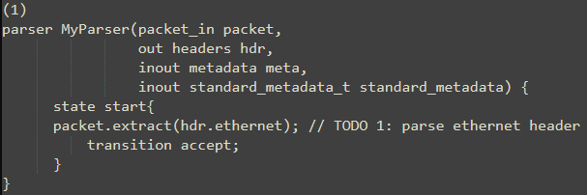
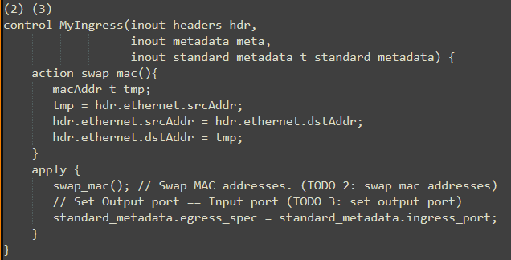
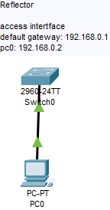
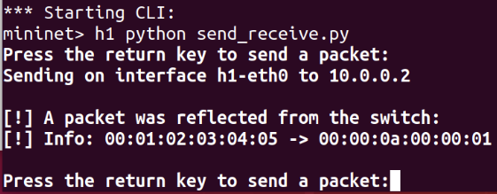
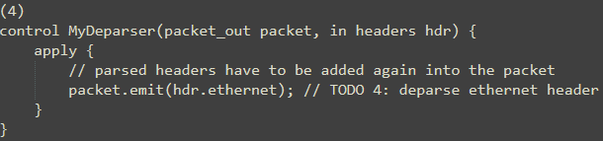
https://github.com/nsg-ethz/p4-learning/tree/master/exercises/01-Reflector

Slide 16
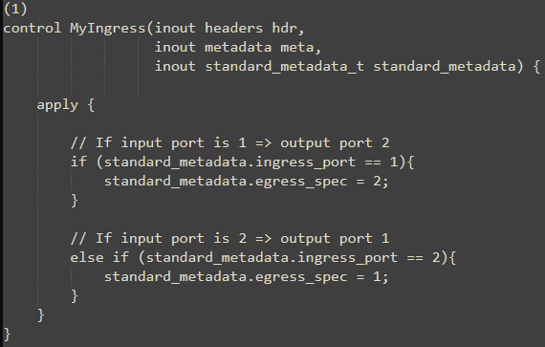
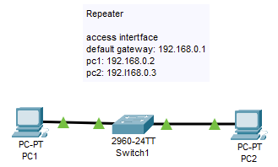
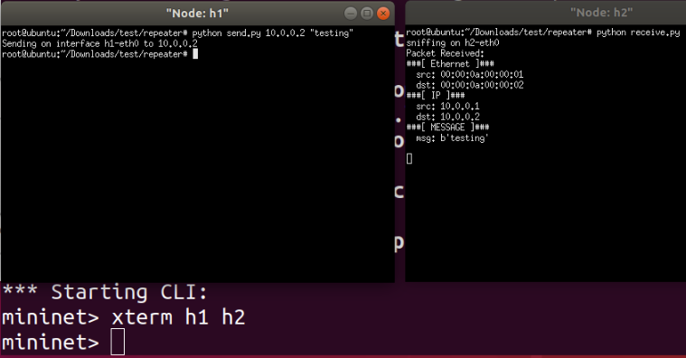
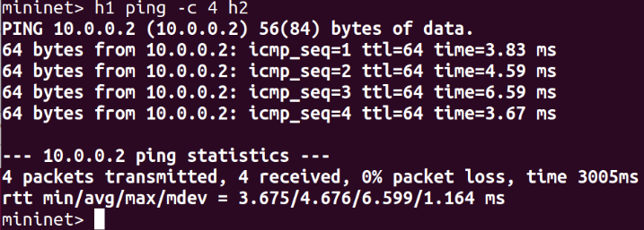
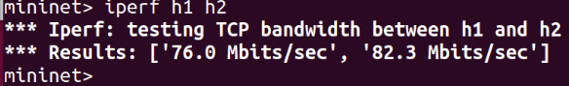
https://github.com/nsg-ethz/p4-learning/tree/master/exercises/02-Repeater/thrift

Slide 18
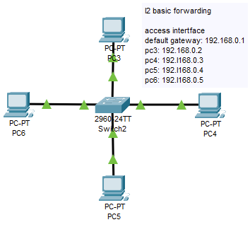
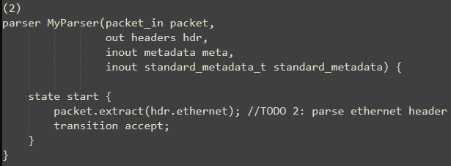
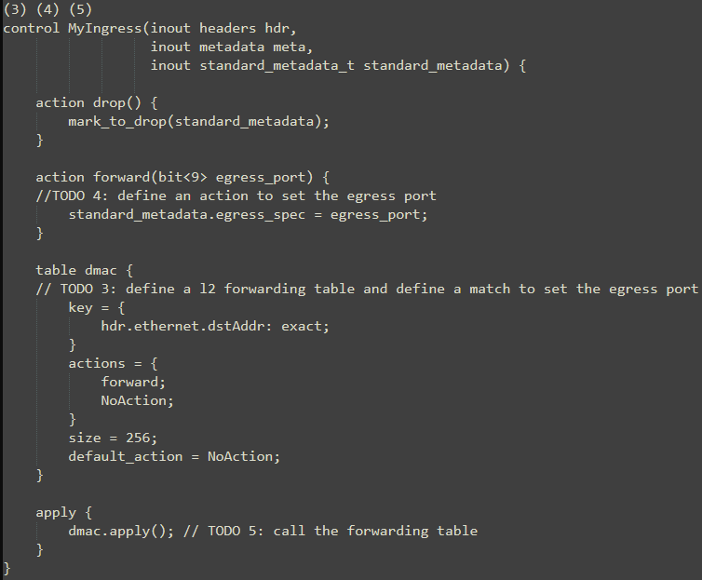
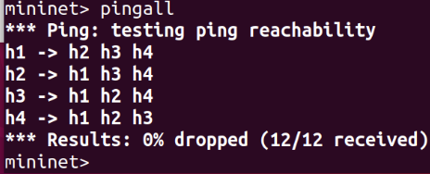
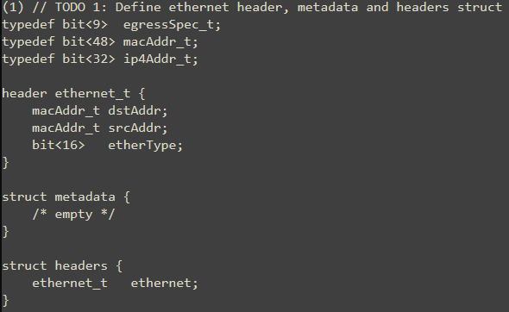
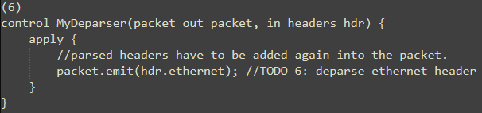
https://github.com/nsg-ethz/p4-learning/tree/master/exercises/03-L2_Basic_forwarding/thrift

Slide 20
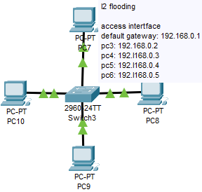
https://github.com/nsg-ethz/p4-learning/tree/master/exercises/03-L2_Flooding/thrift

Slide 21
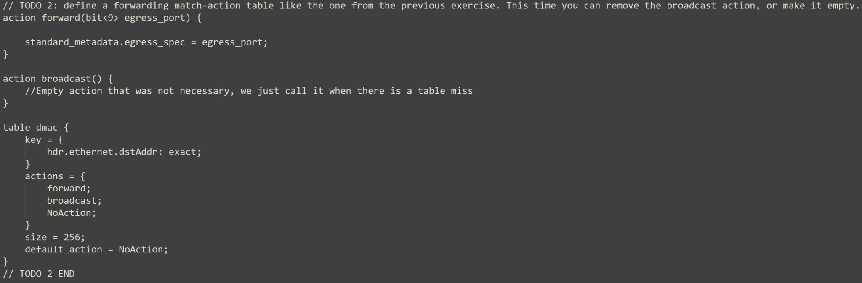

Slide 22
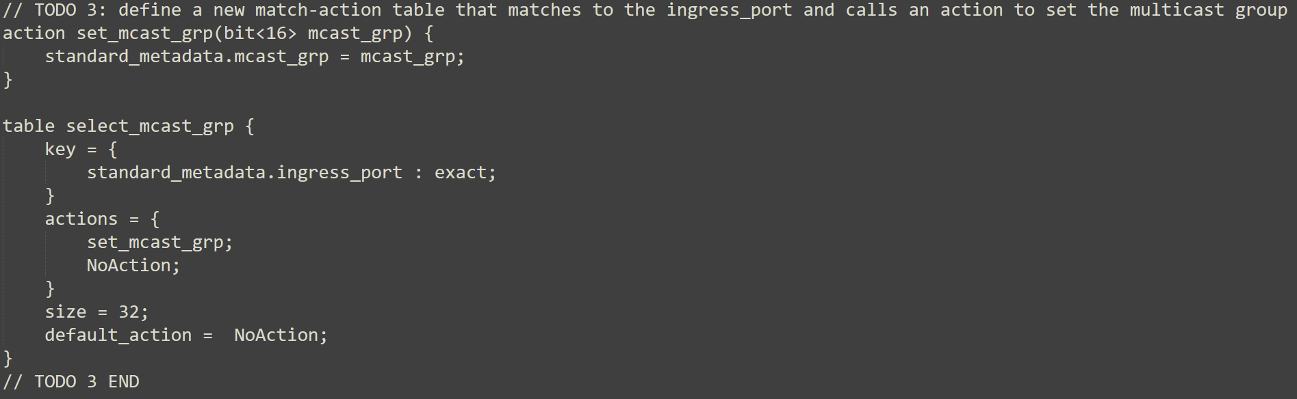

Slide 23
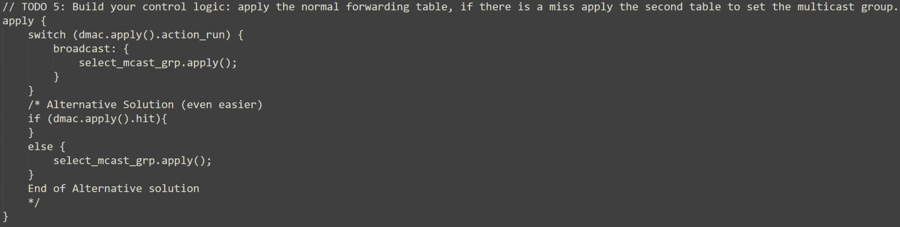

Slide 24
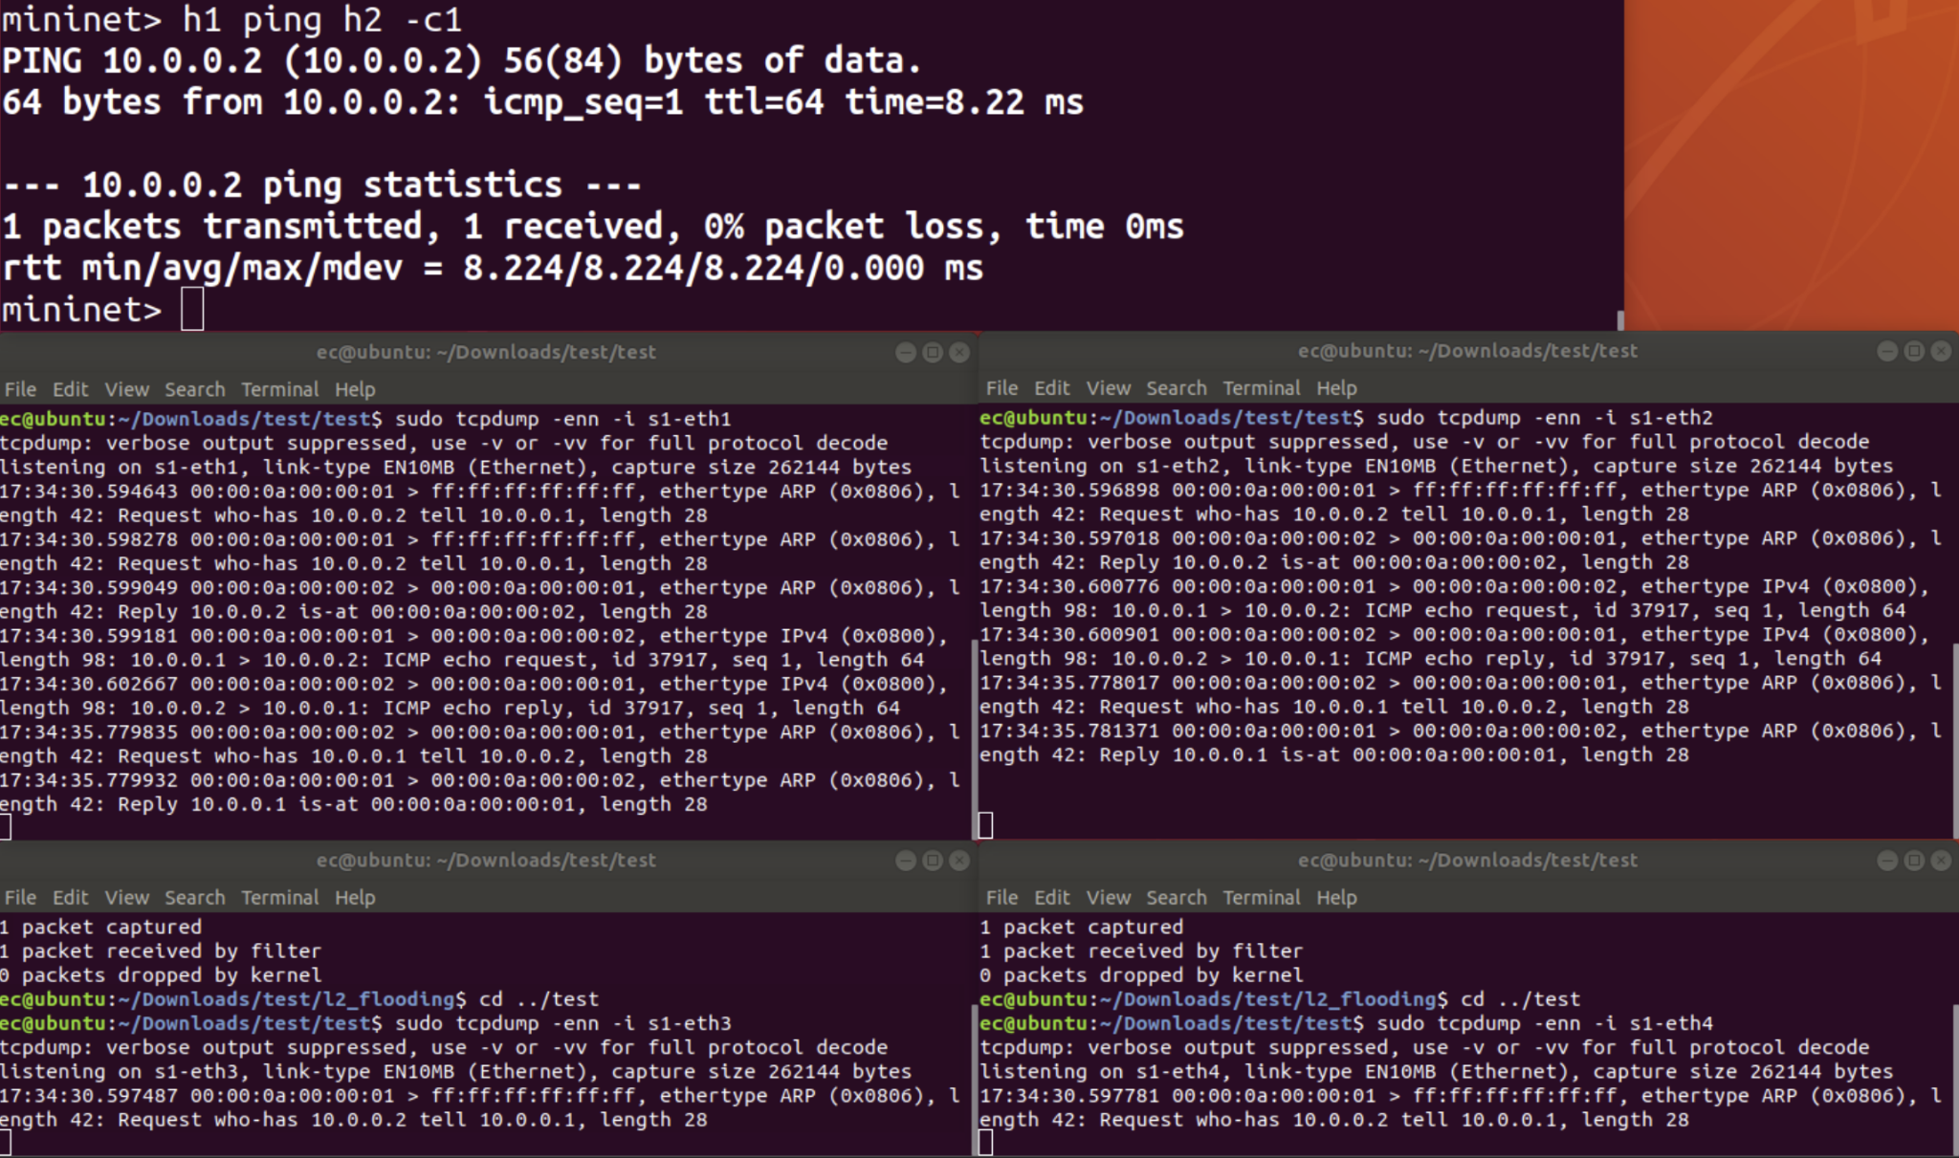
Broadcast all port - sending port will also receive the broadcast which is not correct

Slide 25
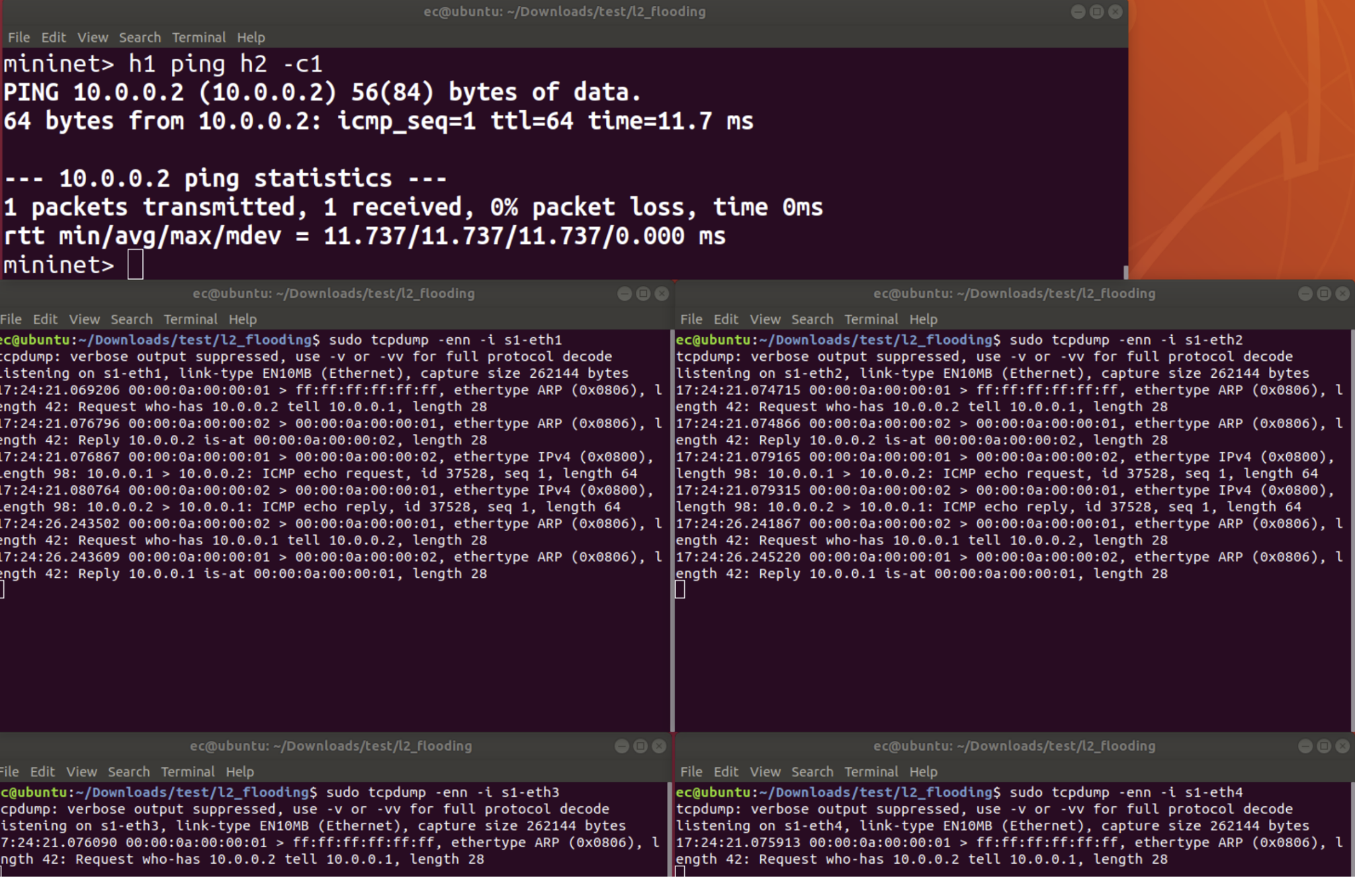
Broadcast other port - sending port will not receive the broadcast which is correct

Slide 26
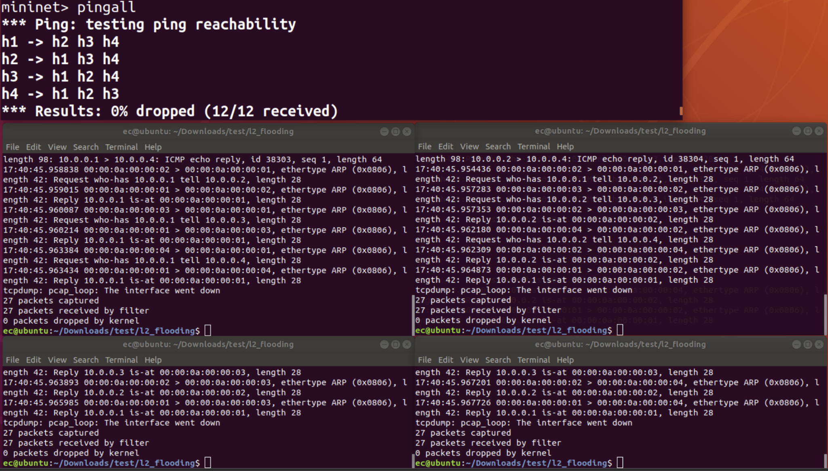
Broadcast other port - pingall success

Slide 28
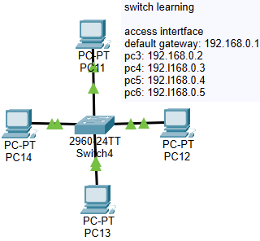
https://github.com/nsg-ethz/p4-learning/tree/master/exercises/04-L2_Learning/thrift

Slide 29
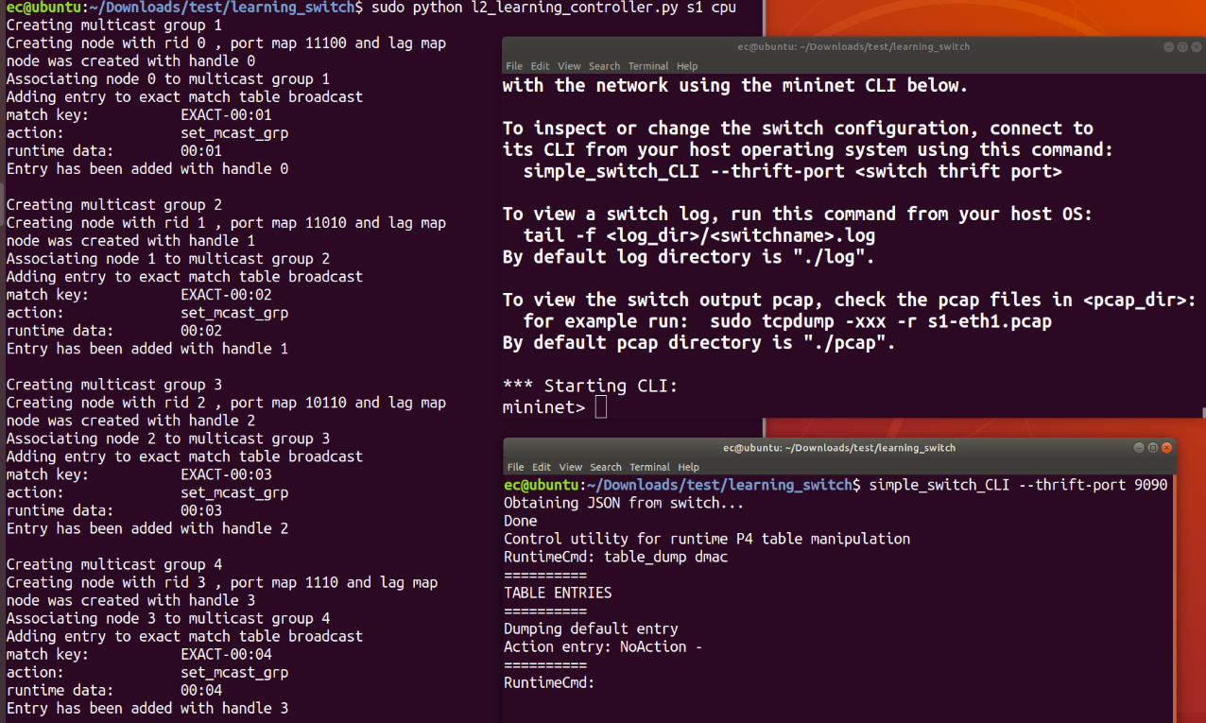
Before pingall - table is empty, nothing is learned yet

Slide 30
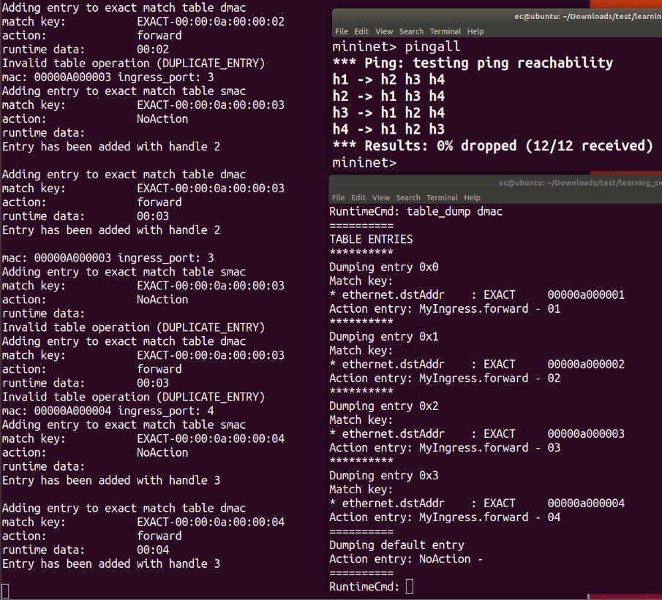
After pingall - table entries is filled, mac address is mapped to port

Slide 31
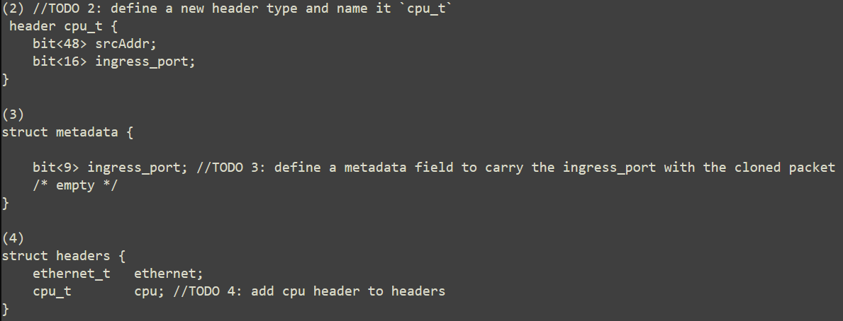

Slide 32
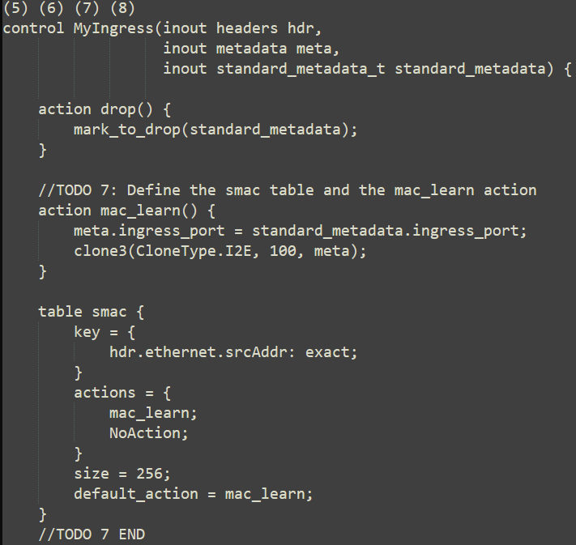
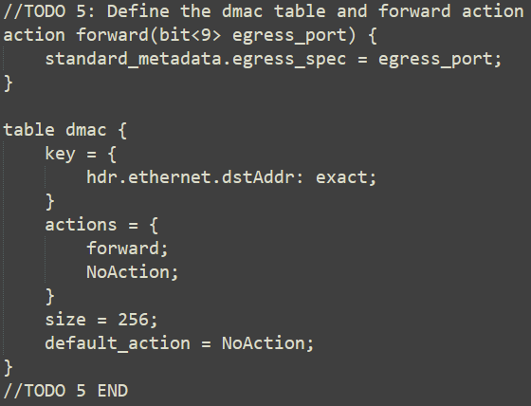
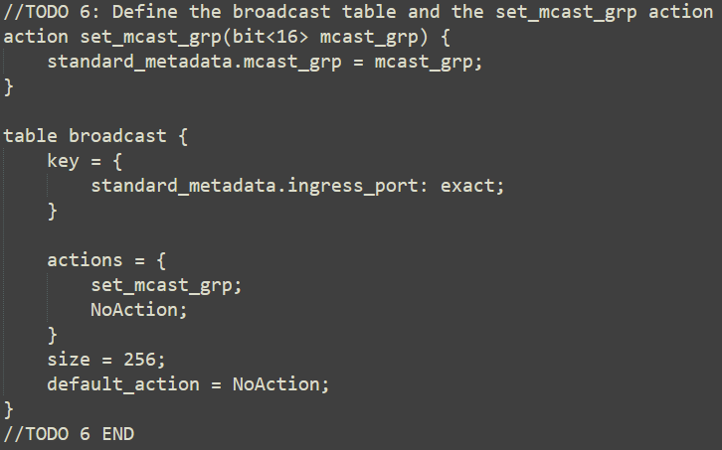
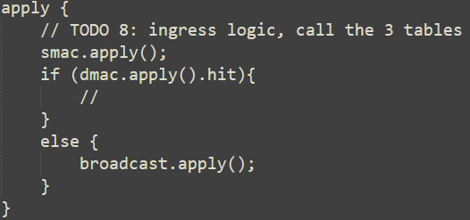

Slide 34
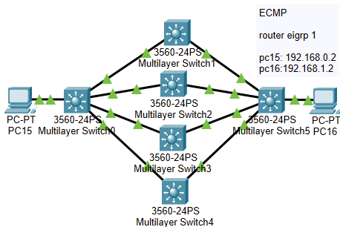
https://github.com/nsg-ethz/p4-learning/tree/master/exercises/05-ECMP

Slide 35
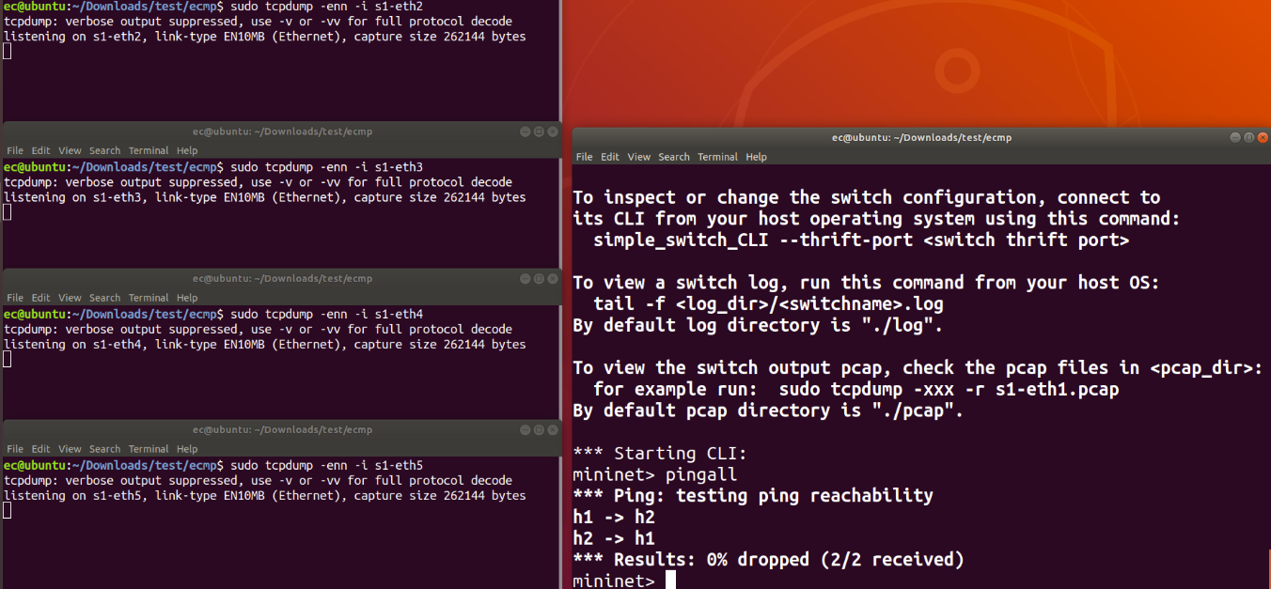
Before ping - all interface has no activity

Slide 36
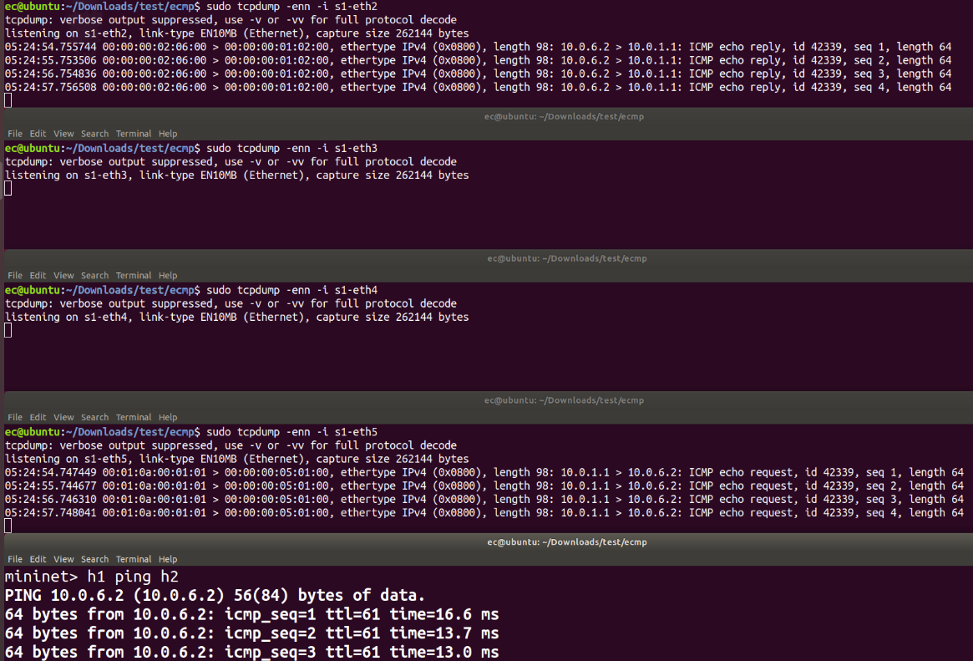
H1 ping h2

Slide 37
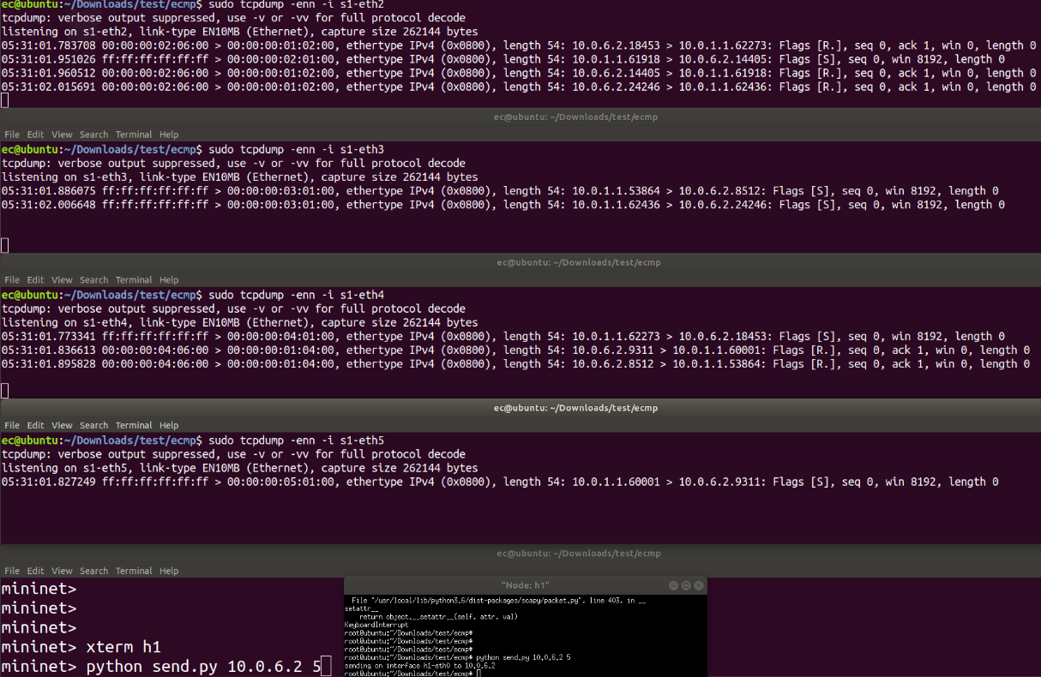
H1 send tcp packet to h2
Packet will move under different 5 tuple hash using different route via load balancing
src ip, dst ip, src port, dst port, protocol

Slide 38
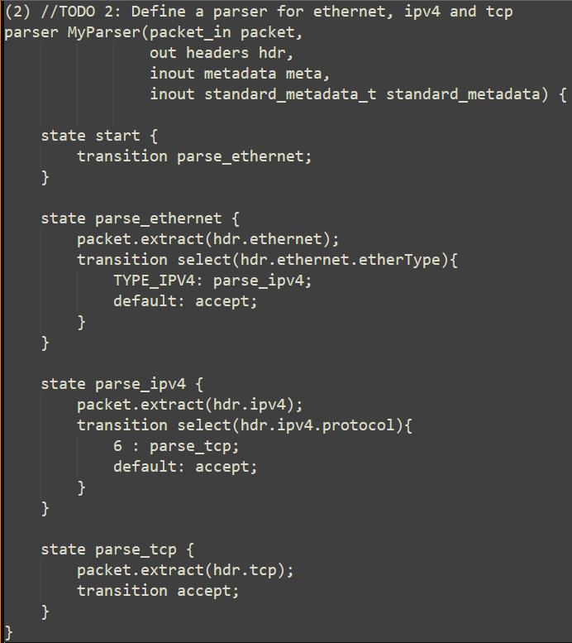
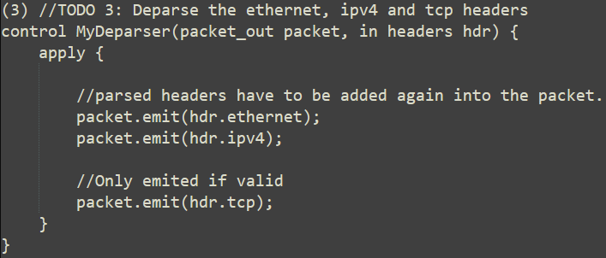
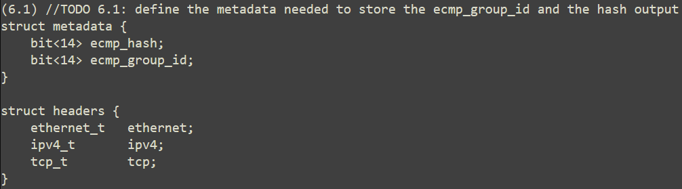

Slide 39
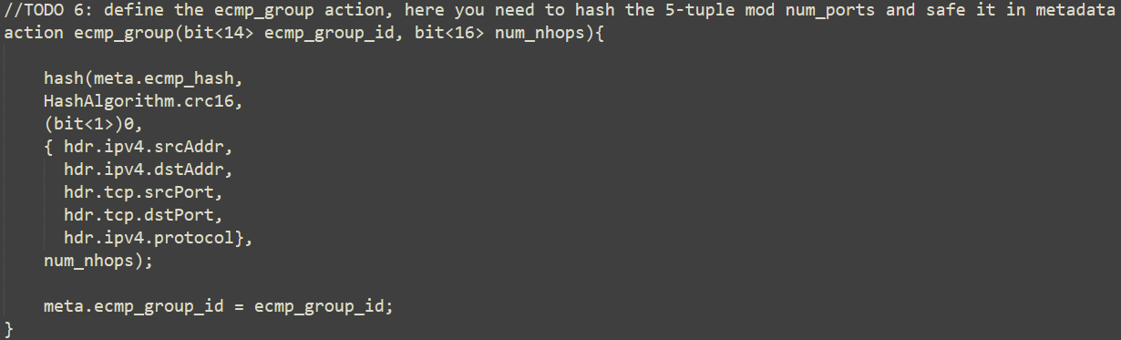
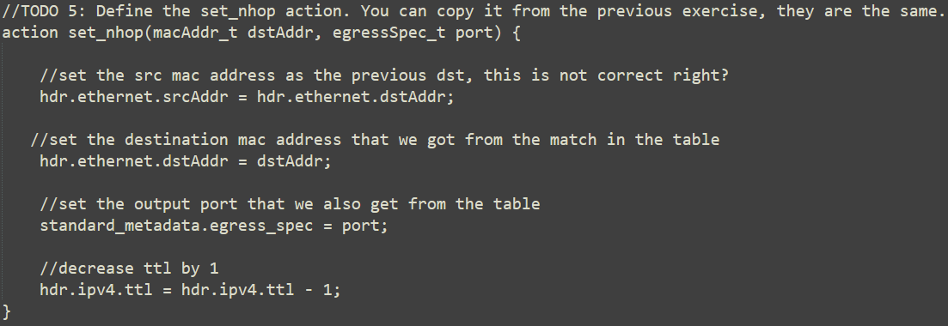
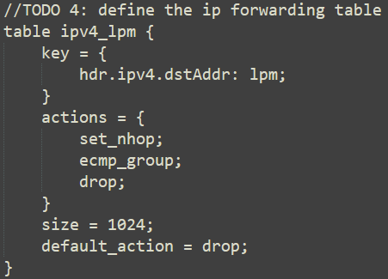

Slide 40
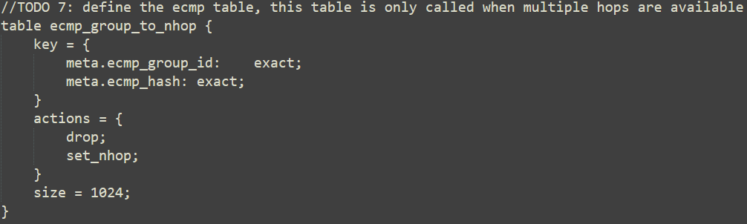
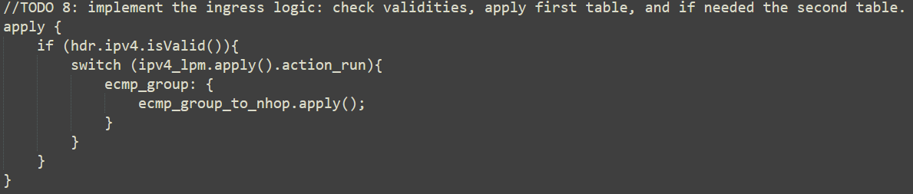

Slide 42
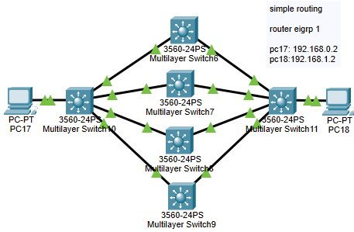
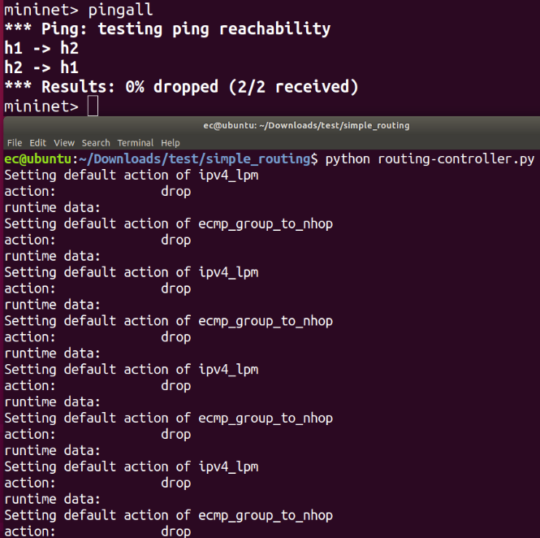
https://github.com/nsg-ethz/p4-learning/tree/master/exercises/08-Simple_Routing/thrift

Slide 43
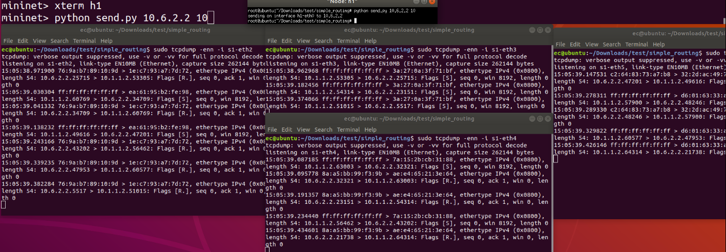

Slide 45
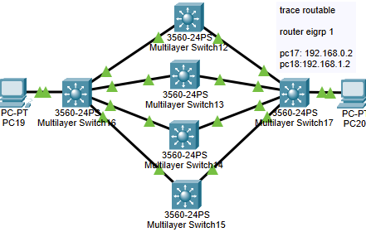
https://github.com/nsg-ethz/p4-learning/tree/master/exercises/09-Traceroutable

Slide 46
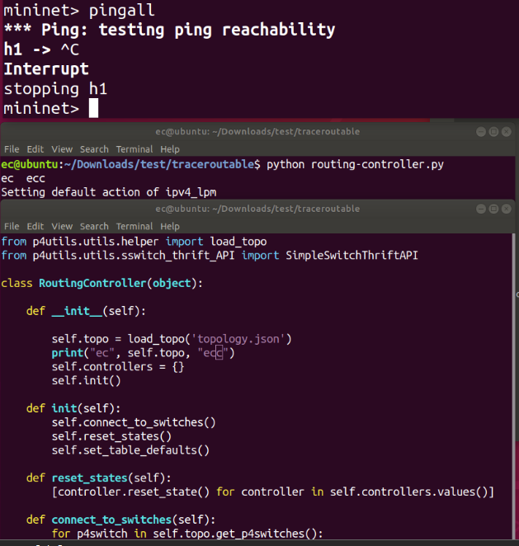
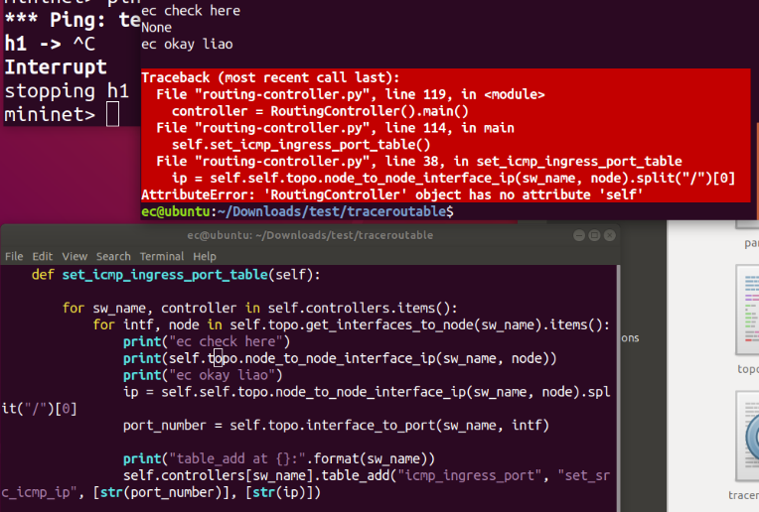

Slide 48


Slide 49



Slide 51

Base p4 mininet topology configuration: workable

Slide 52


Slide 53


Slide 55
Testing to make a external vm as host inside p4 mininet network

Slide 56

Default route

Slide 57



Vm2 default config
Ping test
Vm1 default config

Slide 59




Config h1 to same ip addr as vm2
Unable to ping h2 from h1
Vm2 did not sniff any packet sent out
Unable to ping vm1 from h1
Conclusion: maybe only workable within same network

Slide 61



Vm2 default config part 2
Vm1 default config
Vm2 ping vm1

Slide 62



Config h1 to same ip addr as vm2, H1 unable to ping h2
Vm2 did not sniff any packet sent out
H1 revert its ip addr, unable to ping vm2
Conclusion: suspect the routing table needs to be updated for the new ip addr of h1

Slide 64


Ping from vm2 to h1
H1 did not receive any packet despite successful ping
Conclusion: suspect that the adapter is not able to connect

Slide 66


Add virtual adapter and find vm1 pid
Link a virtual adapter to vm1 and set its gateway and route

Slide 67




Vm1 is linked to the virtual adapter
Add adapter to external vm be readable for all connected vm
Test ping fails
Conclusion: maybe need other ways to connect such as namespace

Slide 69




Create namespace, p4mininet
Same step as previous attempts except its to add config first instead of setting the link as once the link is set, its more troublesome to configure the virtual adapter inside the namespace
Add adapter to external vm be readable for all connected vm
Virtual adapter created

Slide 70


Vm1 pings its external vm
External vm does not receive any packet
Conclusion: fails

Slide 71
NAMESPACE
NAT
P4 mininet host VM
VM1
Visual attempt to use namespace with virtual adapter to connect the 2 vm

